Slide 1
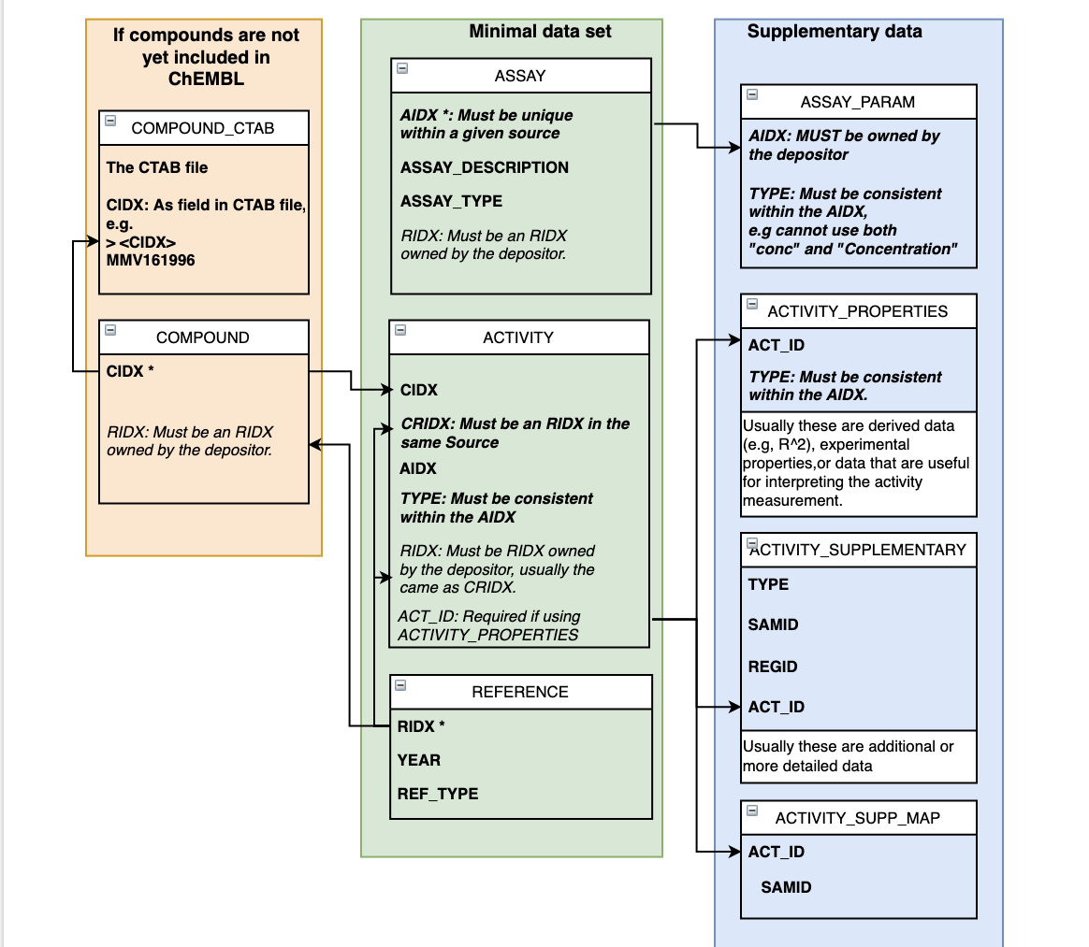
ChEMBL Schema
‘Short user defined identifiers are required for each entity and are recorded under various ID fields: CIDX (=Compound), RIDX (=Document), AIDX (=Assay).
‘Most deposited data is classed as ref_type = ’DATASET’.

Slide 2
Use of tables for EUbOPEN data
ASSAY
Record of a particular multiplex assay
Species, cell line used, etc.
We do not have a specific assay type for multiplex data
ASSAY_PARAM
Records for variables related to the assay
Concentration, incubation time, etc.
Can be a numeric or a text value
ACTIVITY_SUPP_MAP
Links ACTIVITY and ACTIVITY_SUPPLEMENTARY
It is a many-to-one mapping
ACTIVITY
Records for individual observations (e.g. cell counts) within a multiplex assay
Stores the highest level-data.
ACTIVITY_SUPPLEMENTARY can contain data for individual points used to generate a summary statistic.
ACTIVITY_PROPERTIES
Information necessary for interpretation of the ACTIVITY table data
Can be independent variables or dependent variables.
Can be used to supply additional activity information, e.g. Hill slope of a curve
ACTIVITY_SUPPLEMENTARY
More fine-detail or supplementary data on an assay.
e.g. points on a curve, individual information from each animal (for an animal assay)
REFERENCE
Information on a particular series of depositions.
e.g. ‘EUbOPEN Chemogenomics Library wave 1’
Can take a dataset or a publication

Slide 3
Current Multiplex data structure (ASSAY)
ASSAY _ID | DOC _ID | DESCRIPTION | ASSAY _TYPE | ASSAY_ TEST _TYPE | ASSAY_ ORGANISM | ASSAY_TAX _ID | ASSAY _TISSUE | ASSAY_CELL_ TYPE | AIDX | RIDX
2035684 | 118026 | Multiplex assay against human fibroblast | T | In vitro | Homo sapiens | 9606 |  | Fibroblast | MULTI_CQ1-ctf003_human fibroblast | EUbOPEN Chemogenomics Library wave 1
This is where data describing what the assay is should go

Slide 4
Current Multiplex data structure (ASSAY)
ASSAY_ID | RELATION | VALUE | UNITS | TYPE | ACTIVITY_COMMENT | RIDX
2035691 | = | 97 | % | Multiplex | Population Normal (%) | EUbOPEN Chemogenomics Library wave 1
2035691 | = | 18 | % | Multiplex | Population Pyknosed Nuclei (%) | EUbOPEN Chemogenomics Library wave 1
2035691 | = | 0 | % | Multiplex | Population Tubulin-Different-Phenotype (%) | EUbOPEN Chemogenomics Library wave 1
2035691 | = | 1127 |  | Multiplex | Total Cell Count | EUbOPEN Chemogenomics Library wave 1
2035691 | = | 8 | % | Multiplex | Control Dmso Apoptotic Cells (%) | EUbOPEN Chemogenomics Library wave 1
2035691 | = | 9 | % | Multiplex | Control Dmso Fragmented Nuclei % | EUbOPEN Chemogenomics Library wave 1
2035691 | = | 1 | % | Multiplex | Control Dmso Growth Rate | EUbOPEN Chemogenomics Library wave 1
2035691 | = | 86 | % | Multiplex | Control Dmso Healthy Nuclei (%) | EUbOPEN Chemogenomics Library wave 1

Slide 5
Example of Supplementary data (ACTIVITY)
AP_ID | ACTIVITY _ID | TYPE | RELATION | VALUE | UNITS | TEXT_VALUE | STANDARD _TYPE | STANDARD _RELATION | STANDARD _VALUE | STANDARD_UNITS | STANDARD_TEXT _VALUE | COMMENTS | RESULT _FLAG
5336623 | 17876445 | HILLSLOPE | = | 1.85140564 |  |  | HILLSLOPE | = | 1.851 |  |  |  | 1
5336628 | 17876447 | HILLSLOPE | = | 1.00104977 |  |  | HILLSLOPE | = | 1.001 |  |  |  | 1
7564212 | 23071299 | ± SEM |  | 2 | % growth |  | ± SEM |  | 2 | % growth |  |  | 0
7564213 | 23071300 | ± SEM |  | 1 | % growth |  | ± SEM |  | 1 | % growth |  |  | 0
The ACTIVITY data stores the highest levels of activity data. | The Activity table is being used here to store the Hill slope coefficients, but if you had individual points they could go in ACTIVITY_SUPPLEMENTARY.

Slide 6
Current Multiplex data structure (ACTIVITY_PROPERTIES)
AP_ID | ACTIVITY _ID | TYPE | RELATION | VALUE | UNITS | TEXT_VALUE | COMMENTS | RESULT_ FLAG
7126355 | 22579952 | Compound concentration | = | 10 | uM |  |  | 0
7126354 | 22579952 | Growth Rate (GR) | = | 0 |  |  |  | 0
7126356 | 22579952 | Timepoint | = | 0 | hours |  |  | 0
7126324 | 22579742 | Compound concentration | = | 10 | uM |  |  | 0

Slide 7
Example of Supplementary data
SAMID | REGID | RELATION | TEXT_VALUE | TYPE | UNITS | VALUE | COMMENTS
1 |  | = |  | Inhibition at 0.1mM | % inhibition | 0.1
1 |  | = |  | Inhibition at 1mM | % inhibition | 1
1 |  | = |  | Inhibition at 2mM | % inhibition | 2
1 |  | = |  | Inhibition at 3mM | % inhibition | 3
1 |  |  |  | Inhibition at 10mM | % inhibition | 10
Contains supplementary data | This is the correct table for raw results and other supporting info. It is not necessary to supply, for example, all the points on a curve.
Can be grouped by REGID and SAMID | REGID groups by a group, SAMID groups by sample. You can map many ACT_IDS to one sample in the ACT_SUPP_MAP table.
Useful for fine-detail data | It is more useful with datasets such as in vivo studies where animal-level data is submitted.

Slide 8
COMPOUND_RECORD
CIDX | RIDX | COMPOUND_NAME | COMPOUND_KEY
MMV010764 | SGC1 | MMVCompound 010764 | MMV010764
MMV026468 | SGC1 | MMVCompound 026468 | MMV026468
MMV011229 | SGC1 | MMVCompound 011229 | MMV011229
The ACTIVITY_SUPPLEMENTARY table stores individual points on the curve.
The ACT_SUPP_MAP links ACTIVITY records to sample IDs | For example, if you had HILLSLOPE and SEM measurements from the same plate, these could share a SAMPLE ID.

Slide 9
ASSAY
AIDX | RIDX | ASSAY_ DESCRIPTION | ASSAY_ TYPE | ASSAY_ TEST_TYPE | ASSAY_ ORGANISM | ASSAY_ STRAIN | ASSAY_ TAX_ID | TARGET_ TYPE | TARGET_ NAME | TARGET_ ACCESSION | TARGET_ ORGANISM | TARGET_ TAX_ID
EUBSGC1 | SGC1 | Compound was evaluated for the inhibition of human FECH at 10uM | B | In vitro | Homo sapiens |  | 9606 | PROTEIN | FECH | P22830 | Homo sapiens | 9606
EUBSGC2 | SGC1 | Compound was evaluated for the inhibition of human HMBS at 100uM | B | In vitro | Homo sapiens |  | 9606 | PROTEIN | HMBS | P08397 | Homo sapiens | 9606
This file provides a brief description of the assay, | Includes data on the target organism, tissue, cellular fraction etc.
RIDX is optional | If included it must be an RIDX owned by the depositor. Either one in this set of files or one already loaded into ChEMBL.

Slide 10
AIDX DEFINITION
AIDX should not be duplicated within a given source. | For example, if one panel of probes is being used on multiple sites, or be multiple collaborators, there should only be a single AIDX for "All experiments using this panel". Alternatively, each site or group could have one AIDX that refers to "The experiment performed at this location".
AIDX should be maintained for additional depositions to the same source. | Subsequent data that are using the same panel or at the same location should be loaded with the same AIDX.
AIDXs must be unique and should be informative | e.g. a group leader's initials or a short version of the site name. It’s a text field up to 200 characters long, so you should have space.

Slide 11
ASSAY_PARAM
AIDX | TYPE | RELATION | VALUE | UNITS | TEXT_VALUE | COMMENTS
EUBSGC1 | CONC | = | 10 | uM
EUBSGC2 | CONC | = | 100 | uM
This file describes the assay parameters. | For example, here the first two records show the concentration of compound used.
AIDX and TYPE are both mandatory. | Depositors can set their own TYPE categories, but should not use the same TYPE value for different sorts of data.
It is a many-to-one mapping | You can store multiple parameters for one assay.
AIDX is a link to your assays | It must match an existing AIDX owned by the depositor.

Slide 12
ASSAY
AIDX | RIDX | ASSAY_ DESCRIPTION | ASSAY_ TYPE | ASSAY_ TEST_TYPE | ASSAY_ ORGANISM | ASSAY_ STRAIN | ASSAY_ TAX_ID | TARGET_ TYPE | TARGET_ NAME | TARGET_ ACCESSION | TARGET_ ORGANISM | TARGET_ TAX_ID
EUBSGC1 | SGC1 | Compound was evaluated for the inhibition of human FECH at 10uM | B | In vitro | Homo sapiens |  | 9606 | PROTEIN | FECH | P22830 | Homo sapiens | 9606
EUBSGC2 | SGC1 | Compound was evaluated for the inhibition of human HMBS at 100uM | B | In vitro | Homo sapiens |  | 9606 | PROTEIN | HMBS | P08397 | Homo sapiens | 9606
It is possible to load data without a CTAB file. | If you include a CTAB file or will be loading structure data later, the CIDX fields in the CTAB must match the CIDX IDs here.
ACT_ID links to other tables. | ACT_ID is mandatory if providing an ACTIVITY_PROPERTIES or ACTIVITY_SUPPLEMENTARY record that maps to a given line.
Other notes | This table will take non-numerical activity values is submitted in the ACTIVITY_COMMENT field. CRIDX should generally be identical to RIDX.

Slide 13
ASSAY
Assay type
Assay test type (‘in vivo’, ‘in vitro’, ‘ex vivo')
Assay_strain: The organism strain, e.g.‘BALB/c’ for a mouse assay.
Assay_cell_type: The name of the cell line used.
Assay_organism: The species targeted by the assay/
TAX_IDs should be present in NCBI taxonomy browser.
Target type: We have a list of categories for this. E.g. PROTEIN/SUBCELLULAR/CELL_LINE.
Target_name (for proteins, this is often the gene symbol)
Accession (from UniProt)

Slide 14
ACTIVITY
RIDX | CRIDX | CIDX | AIDX | ACT_ID | TYPE | RELATION | VALUE | UPPER_VALUE | UNITS | ACTIVITY_COMMENT
SGC1 | SGC1 | MMV161996 | EUBSGC1 | EUBSGC1_1 | Inhibition |  | 0 |  | % | Not active
SGC1 | SGC1 | MMV202458 | EUBSGC1 | EUBSGC1_2 | Inhibition |  | 1 |  | % | Not active
SGC1 | SGC1 | MMV676395 | EUBSGC1 | EUBSGC1_3 | Inhibition |  | 12 |  | % | Not active
CIDX, AIDX, CRIDX and TYPE are mandatory.
Text results should be submitted to ACTIVITY_COMMENT | This table will take non-numerical activity values if submitted in the ACTIVITY_COMMENT field.
It is possible to load data without a CTAB file. | If you include a CTAB file or will be loading structure data later, the CIDX fields in the CTAB must match the CIDX IDs here.
RIDX is optional | If included it must be an RIDX owned by the depositor. CRIDX should generally be identical to RIDX.
ACT_ID may be mandatory | ACT_ID is mandatory if providing an ACTIVITY_PROPERTIES or ACTIVITY_SUPPLEMENTARY record that maps to a given line.

Slide 15
ACTIVITY_PROPERTIES
ACT_ID | TYPE | RELATION | TEXT_VALUE | UNITS | TEXT_VALUE | COMMENTS | RESULT_FLAG
EUBSGC1 | HILL_SLOPE | = | 1.1 |  |  |  | 0
Can be used to supply additional activity information | For example the Hill slope of a curve.
Should contain information necessary for interpretation of the ACTIVITY table data | Raw results and supporting info belong in the ACTIVITY_SUPPLEMENTARY table
Can contain dependent or independent variables | If RESULT_FLAG is set to 1, it shows the record is a dependent variable/result (e.g., slope) rather than an independent variable/parameter.
TYPE is depositor-defined | Depositors can set their own TYPE categories, but should not use the same TYPE value for different sorts of data.

Slide 16
ACTIVITY_SUPP_MAP
ACT_ID | SAMID
EUBSGC1_1 | 0
EUBSGC1_2 | 1
EUBSGC1_3 | 1
EUBSGC1_4 | 1
Links ACTIVITY and ACTIVITY_SUPPLEMENTARY | This is the correct table for raw results and other supporting info. It is not necessary to supply, for example, all the points on a curve.
It is a many-to-one mapping | You can assign multiple ACT_IDs to one SAM_ID, e.g. multiple results from a single animal (or multiple results from one multiplex plate).

Slide 17
ACTIVITY_SUPPLEMENTARY
SAMID | REGID | RELATION | TEXT_VALUE | TYPE | UNITS | VALUE | COMMENTS
0 | 0 | = |  | Treatment |  | 1
1 | 1 | = |  | Treatment |  | 1
2 | 2 | = |  | Treatment |  | 1
2 | 2 | = | Y | Side Effect (Y,N) | Y,N
Contains supplementary data | This is the correct table for raw results and other supporting info. It is not necessary to supply, for example, all the points on a curve.
Can be grouped by REGID and SAMID | REGID groups by a group, SAMID groups by sample. You can map many ACT_IDS to one sample in the ACT_SUPP_MAP table.
Useful for fine-detail data | It is more useful with datasets such as in vivo studies where animal-level data is submitted.

Slide 18
REFERENCE
RIDX | PUBMED_ID | DOI | TITLE | YEAR | REF_TYPE | ABSTRACT | AUTHORS
1 | 363452 |  | Example Publication | 2022 | PUBLICATION | This is an example publication | A.N. Other, J. R. Hartley
2 |  | http://doi.org/10.6019/EXAMPLE | Example Dataset | 2022 | DATASET | This is an example set of data from the Chemical Studies Project, targeting ATP synthase with inhibitors. The control used for this dataset was DMSO. | The CSP Consortium
Contains information about the publication or dataset | This table should contain enough information to easily identify a publication. For a dataset, it should provide enough context to understand what the data represent.
The ABSTRACT field is still useful for datasets | This should contain a description of the dataset, along with any other relevant metadata such as what was used as a control

Slide 19
TARGET_TYPES
NUCLEIC-ACID NUCLEIC ACID
TISSUE, PROTEIN, ORGANISM,
CELL-LINE, CELL_LINE, CELL LINE
ADMET, UNKNOWN, UNCHECKED, SUBCELLULAR, NO TARGET
PROTEIN COMPLEX, PROTEIN FAMILY, PROTEIN COMPLEX GROUP, CHIMERIC PROTEIN, SELECTIVITY GROUP, PROTEIN\-PROTEIN INTERACTION, SINGLE PROTEIN
MOLECULAR, NON\-MOLECULAR, UNDEFINED, PHENOTYPE, PROTEIN NUCLEIC-ACID COMPLEX
SMALL MOLECULE, OLIGOSACCHARIDE, METAL, LIPID, MACROMOLECULE, Other

Slide 20
ASSAY_TYPES
Binding (B) - Data measuring binding of compound to a molecular target, e.g. Ki, IC50, Kd.
Functional (F) - Data measuring the biological effect of a compound, e.g. %cell death in a cell line, rat weight.
ADMET (A) - ADME data e.g. t1/2, oral bioavailability.
Toxicity (T) - Data measuring toxicity of a compound, e.g., cytotoxicity.
Physicochemical (P) - Assays measuring physicochemical properties of the compounds in the absence of biological material
Unclassified (U) - A small proportion of assays cannot be classified into one of the above categories e.g., ratio of binding vs efficacy.

